Slide 1
WHAT’S NEW
MANAGING COSTS AND OPTIMIZING PERFORMANCE IN SNOWFLAKE
20 min
Bob Morrison
Sr. Solutions Architect | Snowflake
Notes:
https://docs.google.com/document/d/1WFYDpOuBkSbCBg7l2ah6dbXl-mL2taiBVElJ9IFJa8k/edit?tab=t.hq7wljb8c1ed

Slide 2
Safe Harbor and Disclaimers
REV 01.05.24
20 min
Other than statements of historical fact, all information contained in these materials and any accompanying oral commentary (collectively, the “Materials”), including statements regarding (i) Snowflake’s business strategy, plans or priorities, (ii) Snowflake’s new or enhanced products, services, and technology offerings, including those that are under development or not generally available, (iii) market growth, trends, and competitive considerations, (iv) our vision for Snowpark, the Data Cloud, and industry-specific Data Clouds, including the expected benefits and network effects of the Data Cloud; and (v) the integration, interoperability, and availability of Snowflake’s products, services, or technology offerings with or on third-party platforms or products, are forward-looking statements. These forward-looking statements are subject to a number of risks, uncertainties and assumptions, including those described under the heading “Risk Factors” and elsewhere in the Annual Reports on Form 10-K and the Quarterly Reports on Form 10-Q that Snowflake files with the Securities and Exchange Commission. In light of these risks, uncertainties, and assumptions, the future events and trends discussed in the Materials may not occur, and actual results could differ materially and adversely from those anticipated or implied in the forward-looking statements. As a result, you should not rely on any forwarding-looking statements as predictions of future events. Forward-looking statements speak only as of the date the statements are first made and are based on information available to us at the time those statements are made and/or management's good faith belief as of that time. Except as required by law, we undertake no obligation, and do not intend, to update the forward-looking statements in these Materials.
Any future product or roadmap information (collectively, the “Roadmap”) is intended to outline general product direction. The Roadmap is not a commitment, promise, or legal obligation for Snowflake to deliver any future products, features, or functionality; and is not intended to be, and shall not be deemed to be, incorporated into any contract. The actual timing of any product, feature, or functionality that is ultimately made available may be different from what is presented in the Roadmap. The Roadmap information should not be used when making a purchasing decision. In case of conflict between the information contained in the Materials and official Snowflake documentation, official Snowflake documentation should take precedence over these Materials. Further, note that Snowflake has made no determination as to whether separate fees will be charged for any future products, features, and/or functionality which may ultimately be made available. Snowflake may, in its own discretion, choose to charge separate fees for the delivery of any future products, features, and/or functionality which are ultimately made available.
The Materials may contain information provided by third-parties. Snowflake has not independently verified this information, and usage of this information does not mean or imply that Snowflake has adopted this information as its own or independently verified its accuracy.
© 2025 Snowflake Inc. All rights reserved. Snowflake, the Snowflake logo, and all other Snowflake product, feature and service names mentioned in the Materials are registered trademarks or trademarks of Snowflake Inc. in the United States and other countries. All other brand names or logos mentioned or used in the Materials are for identification purposes only and may be the trademarks of their respective holder(s). Snowflake may not be associated with, or be sponsored or endorsed by, any such holder(s).
Notes:
Before we get started, I do want to share that we will be discussing some forward looking statements in today’s presentation.

Slide 3


Bob Morrison
Sr. Solutions Architect
Snowflake

Slide 4
AGENDA
20 min
Introduction
Visibility
Control
Optimization
The FinOps Foundation

Slide 5
INTRODUCTION
20 min

Slide 6
The Customer Journey
20 min
Visibility
Understand costs
and performance
Control
Limit and control spend
Optimization
Optimize costs and performance
Notes:
High level slide that we talk to, similar to last year’s (link)

Slide 7
Cost and Performance Management on Snowflake
20 min
Visibility
Understand costs
and performance
Control
Limit and
control spend
Optimization
Optimize costs
and performance
Cost Data
Account & Org Overviews
Account-Level Cost Attribution
Cost-Based Anomaly Detection (PuPr)
Org-Level Query Cost Attribution (PrPr Soon)
Non Admin Access (GA)
Performance Data
Query History & Profile
Performance Explorer (GA Soon)
Grouped Query History & Profile (PuPr)
Budgets
Account-Level Budgets
Custom Budgets
By Resource
By Tag (GA soon)
Warehouse Controls
Warehouse sizing & scaling
Auto-Suspend/Resume
Resource Monitors
Optimization Features
Automatic Clustering (AC)
Query Acceleration Service (QAS)
Expanded QAS eligibility (GA)
Search Optimization (SO)
Optimization Data
Detailed Pruning History Views (PuPr)
Insights & Recommendations
Query Insights (PuPr)
Cost Insights
Cost Insights for Large Query Gaps (PrPr)
COST & PERFORMANCE MANAGEMENT IN SNOWSIGHT & PROGRAMMATIC INTERFACES
Notes:
Visibility
Performance Explorer (GA Soon): Snowsight dashboard to help you review the performance of your SQL workloads
Grouped Query History - Query History at the recurring query level, grouped by parameterized query hash
Optimization
Detailed Pruning History Views (PrPr, GA Soon): Two new account usage views that help you understand the pruning efficiency of your queries
Query Insights (PrPr, GA Soon): Query Insights automatically identify reasons for poor query performance, and suggest optimizations.

Slide 8
VISIBILITY
Notes:
put a tldr of the theme for visibility

Slide 9
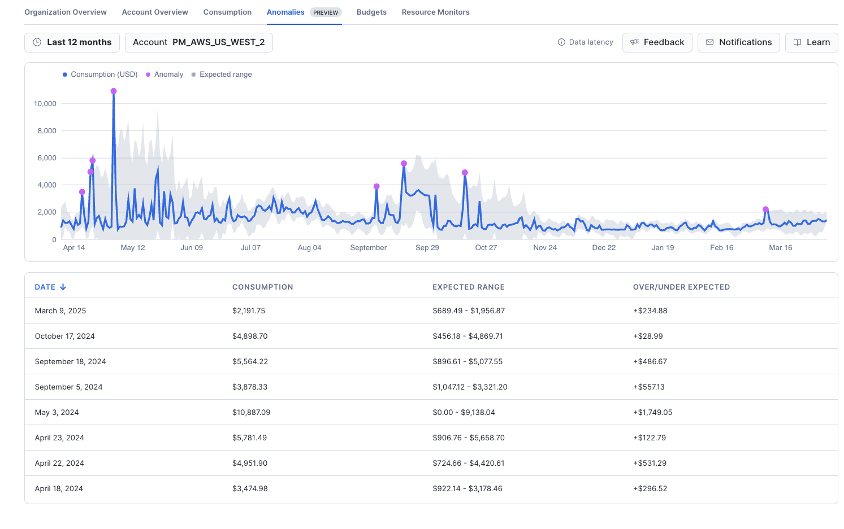
Cost-Based Anomaly Detection
In Dev
Private
Public
GA
WHAT IS IT
A dashboard, views and stored procedures to monitor anomalies in spending with the ability to receive notifications.
WHY USE IT
Detect and track unexpected spending.
HOW TO USE IT
From Snowsight:
Admin » Cost Management » Anomalies.
Also accessible from views in the ACCOUNT_USAGE schema and ORGANIZATION_USAGE schema in ORGADMIN enabled accounts and the ORGANIZATION account.
9

Slide 10
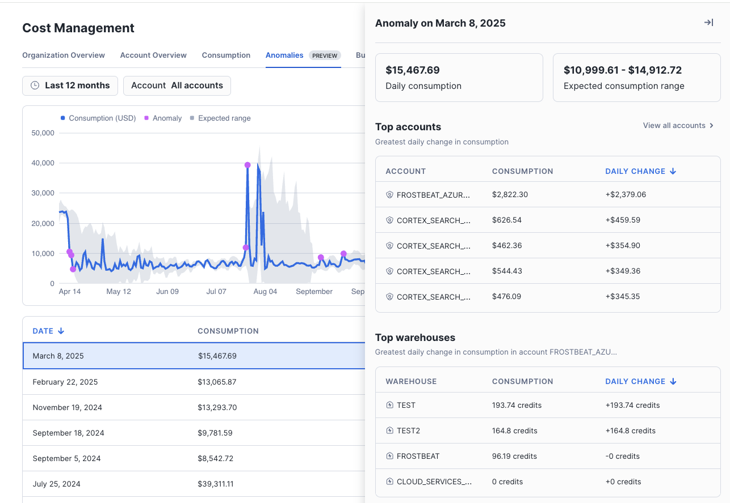
View Organization Anomalies
Available in the Organization Account or ORGADMIN enabled account
Identify top 5 Accounts with the greatest daily change
Identify the top 5 warehouses for each such account

Slide 11
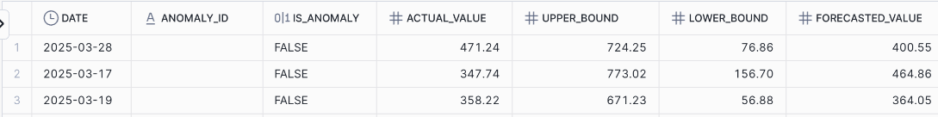
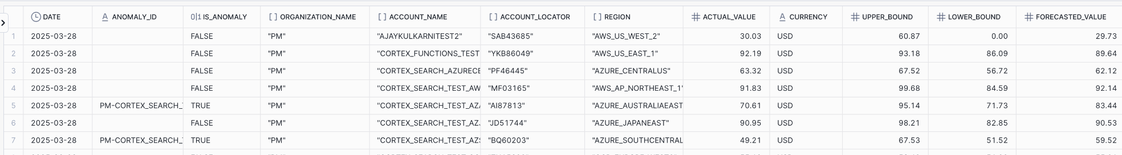
Cost Anomaly Views
ANOMALIES_DAILY :
Located in
SNOWFLAKE.ACCOUNT_USAGE
in all accounts
ANOMALIES_IN_CURRENCY_DAILY :
Located in
SNOWFLAKE.ORGANIZATION_USAGE
in an
ORGADMIN
enabled account or Organization account
Notes:
Notes:
Consider adding a slide for the the view in a non org account where its only credits that are shown.

Slide 12
Programmatic Interface for Anomalies
Skip if low on time
/SNOWFLAKE.LOCAL.ANOMALY_INSIGHTS!GET_DAILY_CONSUMPTION_ANOMALY_DATA( '<start_date>', '<end_date>', <account_name> )
SNOWFLAKE.LOCAL.ANOMALY_INSIGHTS!GET_TOP_ACCOUNTS_BY_CONSUMPTION( '<date>', <number_of_accounts> )
SNOWFLAKE.LOCAL.ANOMALY_INSIGHTS!GET_TOP_WAREHOUSES_ON_DATE( '<date>', <number_of_warehouses>, <account_name> )
SNOWFLAKE.LOCAL.ANOMALY_INSIGHTS!GET_TOP_QUERIES_FROM_WAREHOUSE( <warehouse_id>,'<date>',<number_of_queries> )
SNOWFLAKE.LOCAL.ANOMALY_INSIGHTS!SET_ACCOUNT_NOTIFICATION_EMAILS( '<email_address> [, <email_address> ... ]' )
List anomalies for a given time range and account scope
Show accounts with the largest change in consumption
Display warehouses with the biggest change in consumption for a given account
Enumerate expensive queries in a warehouse
Set email addresses for notifications

Slide 13
Non-Admin Roles for Cost Management
In Dev
Private
Public
GA
WHAT IS IT
Two pairs of roles to grant Admin and Viewer access to cost management functionality.
Persona
Application Role
Database Role
WHY USE IT
Usage Viewer
APP_USAGE_VIEWER
USAGE_VIEWER
Eliminates the need to assign separate roles for every feature in cost management.
Usage Admin
APP_USAGE_ADMIN
USAGE_ADMIN
HOW TO USE IT
Assign the application and database roles for a persona to an account level role and then grant that account level role to users as needed.
Notes:
potentially a picture

Slide 14
Org-Level Query Cost Attribution
In Dev
Private
Public
GA
SOON
WHAT IS IT
SHARED WAREHOUSE
A new view named QUERY_ATTRIBUTION_HISTORY in the ORGANIZATION_USAGE schema of the Organization Account. This view is the union of all the account level views in the organization.
COST_CENTER = Finance
COST_CENTER = Finance
COST_CENTER = Central IT
COST_CENTER = Central IT
COST_CENTER = Marketing
COST_CENTER = Marketing
Shared warehouse
WHY USE IT
Enables cost attribution for shared warehouses for the entire organization from the Organization Account.
APPLICATION LEVEL SHARING
COST_CENTER = Finance
COST_CENTER = Finance
App powered by Snowflake
COST_CENTER = Central IT
App powered by Snowflake
COST_CENTER = Central IT
COST_CENTER = Marketing
COST_CENTER = Marketing
Application level sharing
Notes:
Alternate slide to 23
[sye] Still feel like “What Is It” Should actually say what query cost attribution actually does

Slide 15
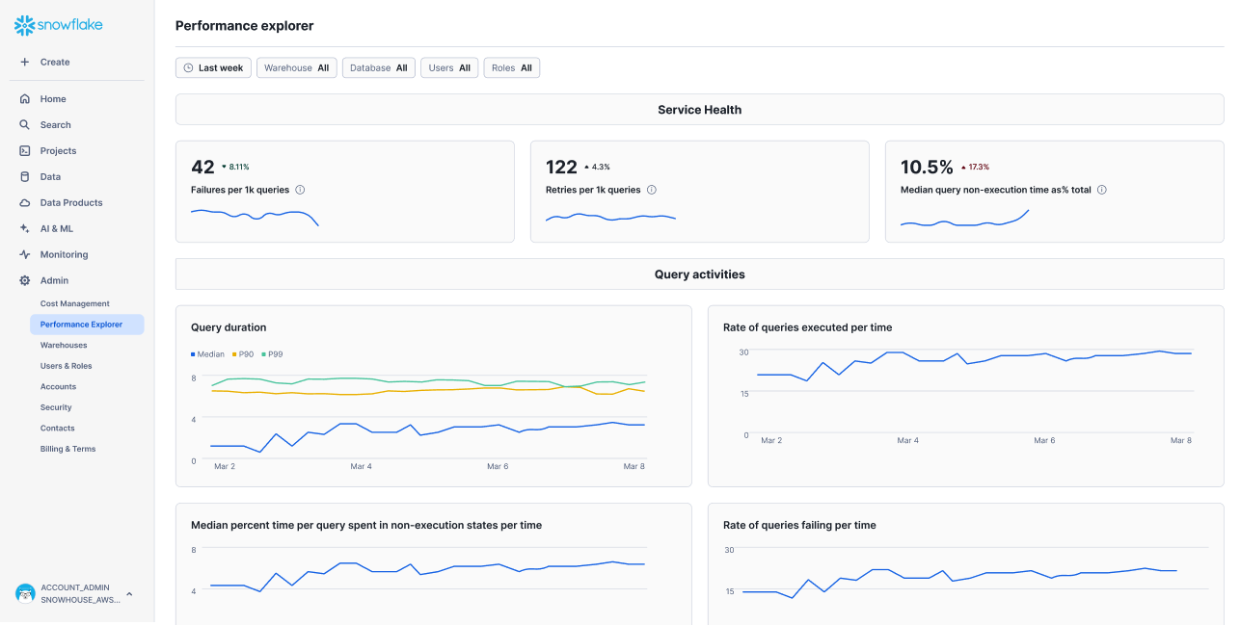
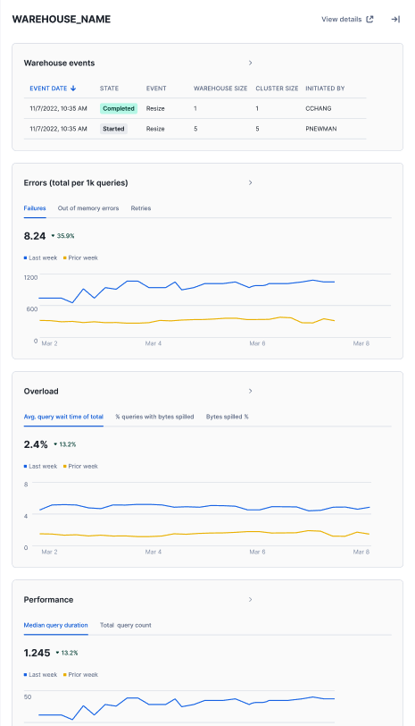
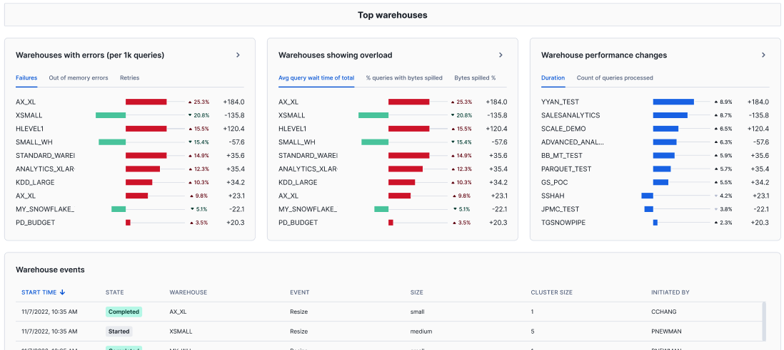
Performance Explorer
In Dev
Private
Public
GA
SOON
WHAT IS IT
A Snowsight dashboard to help you review the performance of your SQL workloads, covering key query, warehouse, and table metrics.
WHY USE IT
Quickly review, understand, and investigate the performance and health of SQL workloads, and identify opportunities for optimization.
HOW TO USE IT
Navigate to Monitoring » Performance Explorer in Snowsight.

Slide 16
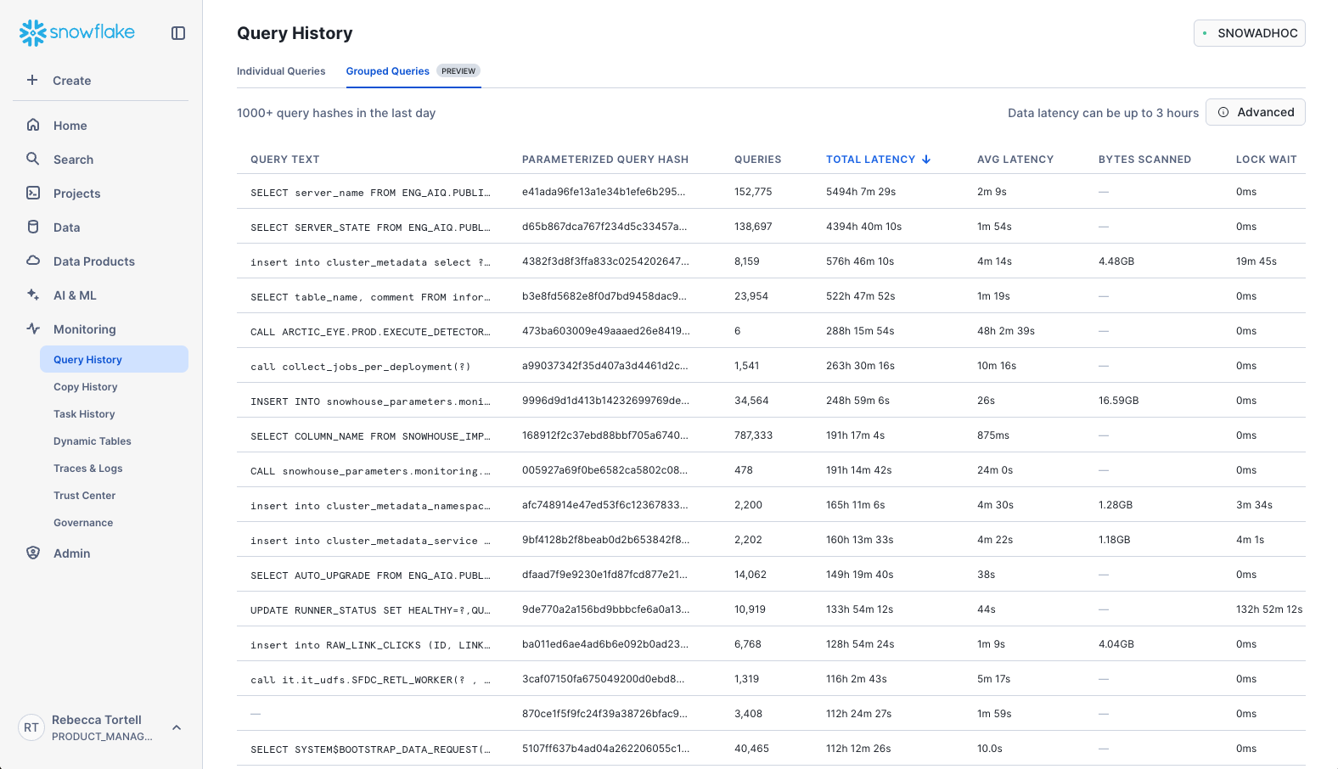
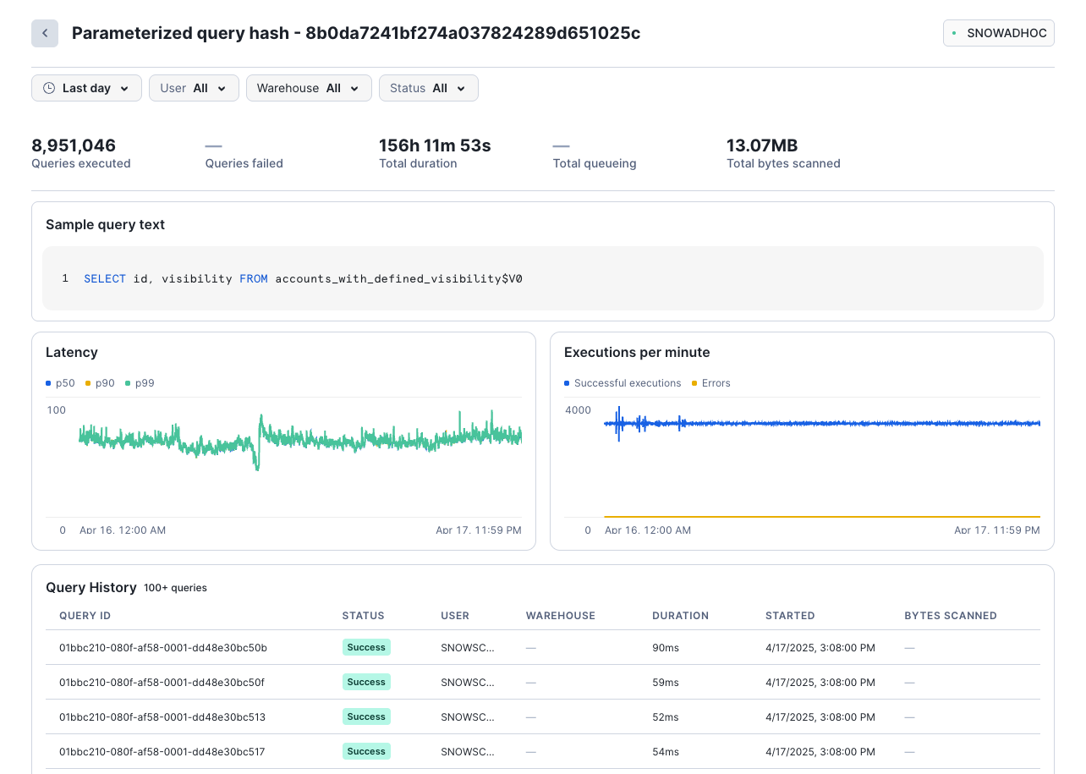
Grouped Query History & Query Profile
In Dev
Private
Public
GA
WHAT IS IT
Query History at the recurring query level, grouped by parameterized query hash
WHY USE IT
View and track the performance of recurring queries, especially low-latency, high-volume queries (e.g., on Hybrid Tables)
HOW TO USE IT
Navigate to Monitoring » Query History in Snowsight
16

Slide 17
Detailed Pruning History Views
In Dev
Private
Public
GA
Example: Partition and row pruning stats for a query
WHAT IS IT
SELECT
TABLE_NAME,
COLUMN_NAME,
ACCESS_TYPE,
SEARCH_OPTIMIZATION_SUPPORTED_EXPRESSIONS,
PARTITIONS_PRUNED,
PARTITIONS_SCANNED,
ROWS_PRUNED, ROWS_SCANNED,
ROWS_MATCHED
FROM
SNOWFLAKE.ACCOUNT_USAGE.COLUMN_QUERY_PRUNING_HISTORY
WHERE
WAREHOUSE_NAME = ‘DHMEDIUM’
GROUP BY ALL
;
Two new account usage views with detailed pruning statistics:
TABLE_QUERY PRUNING_HISTORY
COLUMN_QUERY_PRUNING_HISTORY
WHY USE IT
Understand the pruning efficiency of your queries and identify potential optimization opportunities (e.g., for Automatic Clustering and Search Optimization).
HOW TO USE IT
Query the account usage views directly.

Slide 18
CONTROL

Slide 19
Setting up Global Tags in the Organization
Organization Account
Schema - Cost_Management. Tags
name
allowed_values
GlobalOrgAdmin
COST_CENTER
[“engineering”,”finance”,”
PRIVACY_CATEG-
[“IDENTIFIER”,”INSENSIT
SECURITY
[“low”, “medium”, “high”]
Account 1
Account 2
Account N
Cost_Management
(replica)
Cost_Management
(replica)
Cost_Management
(replica)
Notes:
Potentially any account can be used as the Hub. Preferably though use the Org account or OrgAdmin enabled account

Slide 20
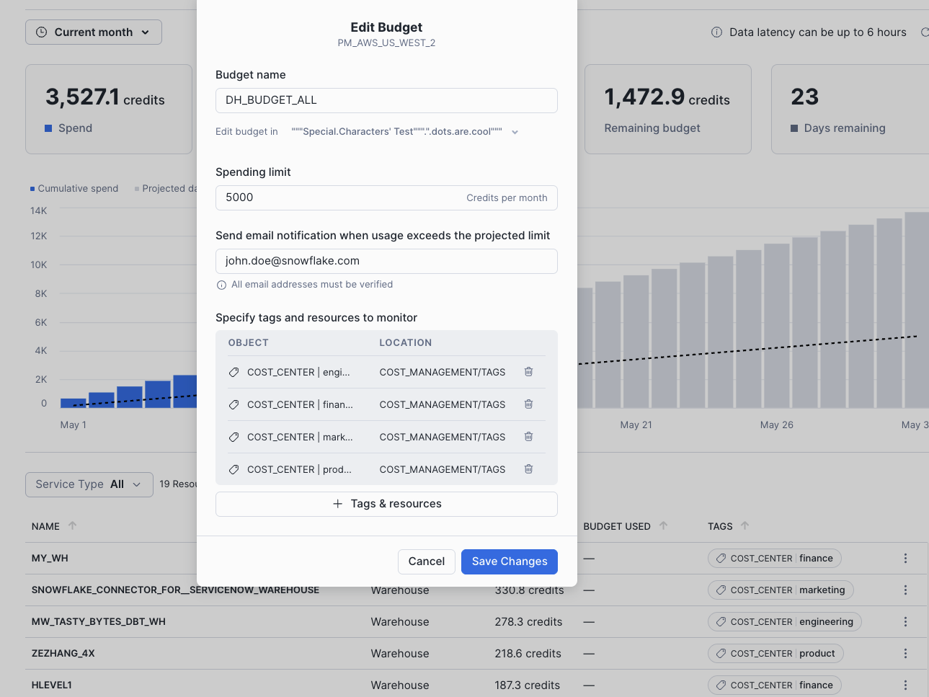
Tag-Based Budgets
In Dev
Private
Public
GA
SOON
WHAT IS IT
Tag-based budgets establish spending limits for resources based on the tags they are associated with.
WHY USE IT
Tags simplify the process of both associating resources to teams or business units and establishing spending limits for those entities.
HOW TO USE IT
Create budgets via Snowsight: go to Admin » Cost Management » Budgets or via SQL commands.
Notes:
Add non dark mode slides when available. also add spend display

Slide 21
Programmatic Interface for Budgets
create snowflake.core.budget my_budget_eng();
call my_budget_eng!add_tag((select system$reference('TAG', 'COST_CENTER', 'SESSION', 'APPLYBUDGET')), 'engineering');
call my_budget_eng!set_spending_limit(150);
call my_budget_eng!set_email_notifications('bob@snowflake.com');
// enumerate the tags linked to this budget
call my_budget_eng!get_linked_tags();
// tally the spending with this budget
call my_budget_eng!get_spending_history('2025-04-01', '2025-04-10')
Interface enables
Automation scripts
Custom Dashboards
Custom Management Console

Slide 22
OPTIMIZATION

Slide 23
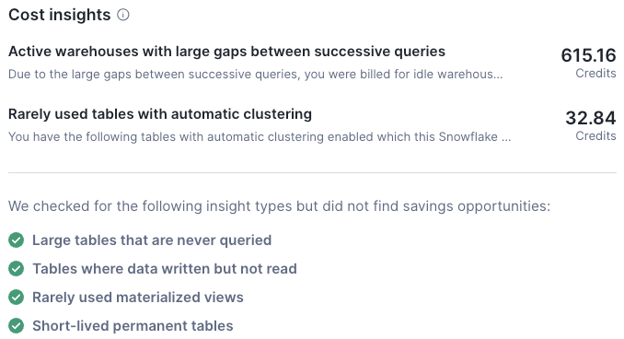
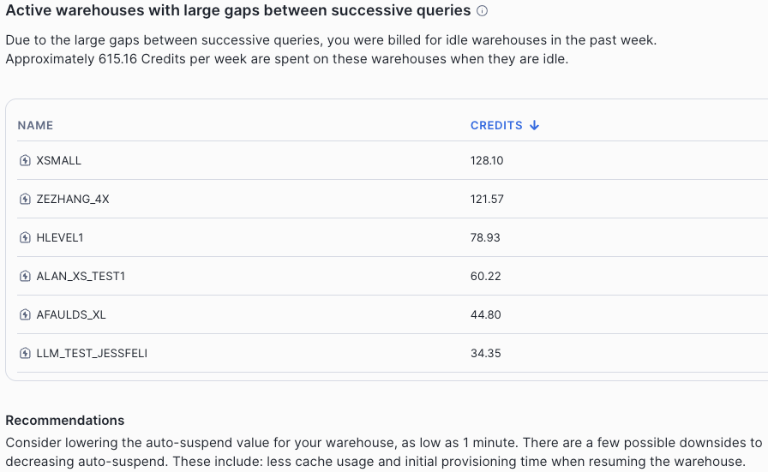
Detect Large Intervals Between Queries
In Dev
Private
Public
GA
WHAT IS IT
An insight that flags instances where large intervals between consecutive queries result in consumption of idle credits.
WHY USE IT
The insight can be used to tune warehouse auto-shutdown times and thus reduce consumption of idle credits.
HOW TO USE IT
Navigate to Admin » Cost Management » Account Overview, and look for the cost insights tile.
Notes:
Ops notes
Reports warehouses where
Idle time > 50%
and
auto-suspend > 5 minutes

Slide 24
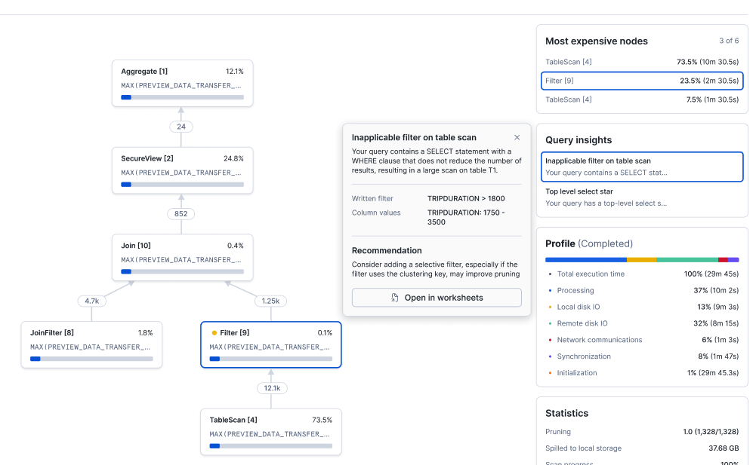
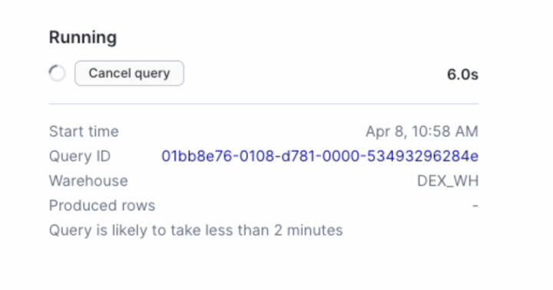
Query Insights
In Dev
Private
Public
GA
WHAT IS IT
Query Insights automatically identify common contributors to poor query performance, and suggests optimizations.
WHY USE IT
Accelerate your performance investigations in Snowsight, or search for queries across your account that might benefit from optimization.
HOW TO USE IT
Navigate to Monitoring » Query History » Query Profile, or programmatically access insights via the QUERY_INSIGHTS account usage view.
Notes:
Finally who doesn’t love having saving opportunities out of box , as we talked about cost insights, this feature pretty much gives you a list of saving opportunities if they are applicable !!

Slide 25
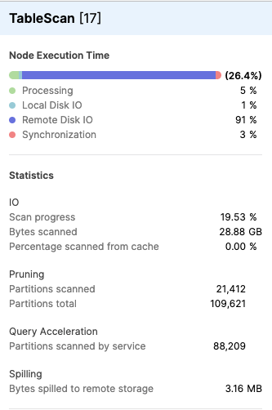
Query Acceleration Service Eligibility Improvements
In Dev
Private
Public
GA
WHAT IS IT
Query Acceleration Service (QAS) can now accelerate ~50% more queries due to added support for Iceberg Tables and backend QAS optimizations.
WHY USE IT
QAS can help accelerate certain parallelizable, scan-heavy queries by opportunistically applying a burst of compute power resources.
HOW TO USE IT
Enable QAS on your warehouses: as we expand QAS eligibility, you automatically benefit.

Slide 26
Intelligent Workload Optimizations
In Dev
Private
Public
GA
SOON
Automatic pruning via workload-specific metadata and search optimization
WHAT IS IT
We automatically analyze the queries you run and generate workload-specific metadata and indexes to improve pruning efficiency
WHY USE IT
Workload-specific metadata and indexes can significantly accelerate your queries through via enhanced micro-partition pruning
HOW TO USE IT
Simply run your queries on Gen2 or Adaptive warehouses and intelligent workload optimizations will be automatically applied
Notes:
[3:05/35s] - In particular, I’m excited about a capability we’ll be GAing soon

Slide 27
THANK YOU

